Slide 1
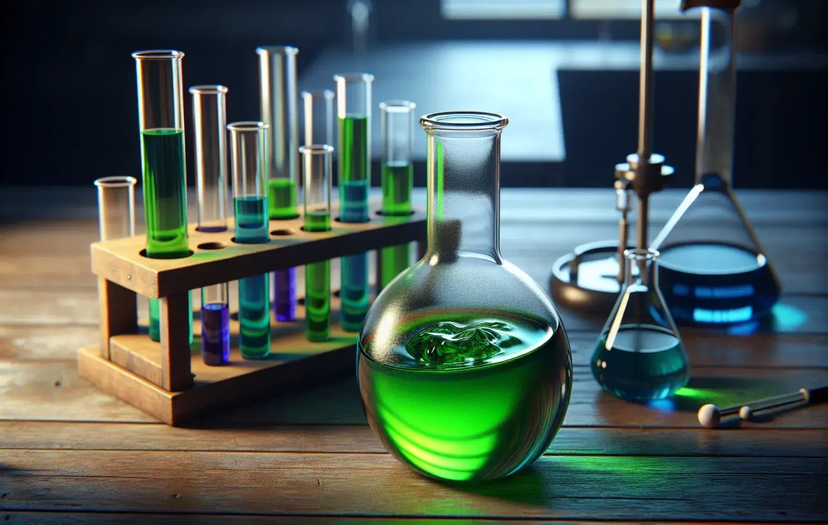
Organic Reactions
An organic reaction is a chemical reaction involving organic compounds. These compounds are made of carbon and hydrogen, often with other elements like oxygen, nitrogen, sulfur, and halogens.
Common Types of Organic Reactions:
Addition reactions
Substitution reactions
Elimination reactions
Redox reactions
Rearrangement reactions

Slide 2
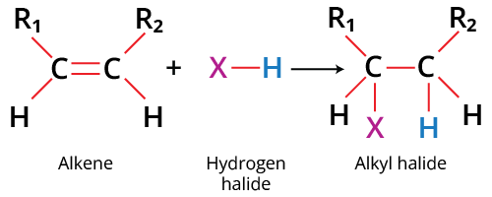
Addition Reactions
Addition reactions are a type of organic reaction in which two atoms or groups are added across a double or triple bond, typically in alkenes or alkynes. These reactions convert multiple bonds into single bonds .
Electrophiles are electron-deficient species that are attracted to electron-rich sites. They accept a lone pair of electrons from others to form a new covalent bond.
Ex: Cations, Lewis acids, Free radicals

Slide 3
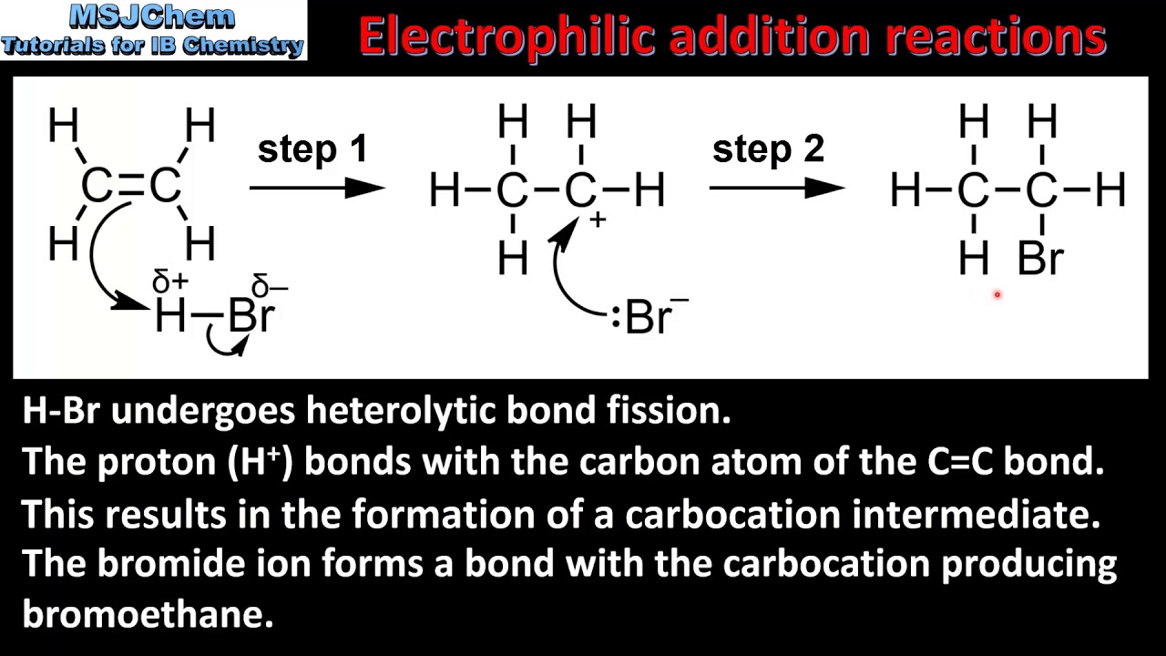
Electrophilic Addition Reactions
This is a type of chemical reaction where an electrophile reacts with a compound containing a double or triple bond to form a more saturated product.
Key Characteristics:
Alkenes attacks electrophile.
This leads to form carbocation.
A nucleophile adds to carbocation to complete the reaction.
In electrophilic addition reactions of asymmetric alkenes, the product formation follows either Markovnikov’s Rule or Anti-Markovnikov’s Rule, depending on the reagents and reaction conditions.

Slide 4
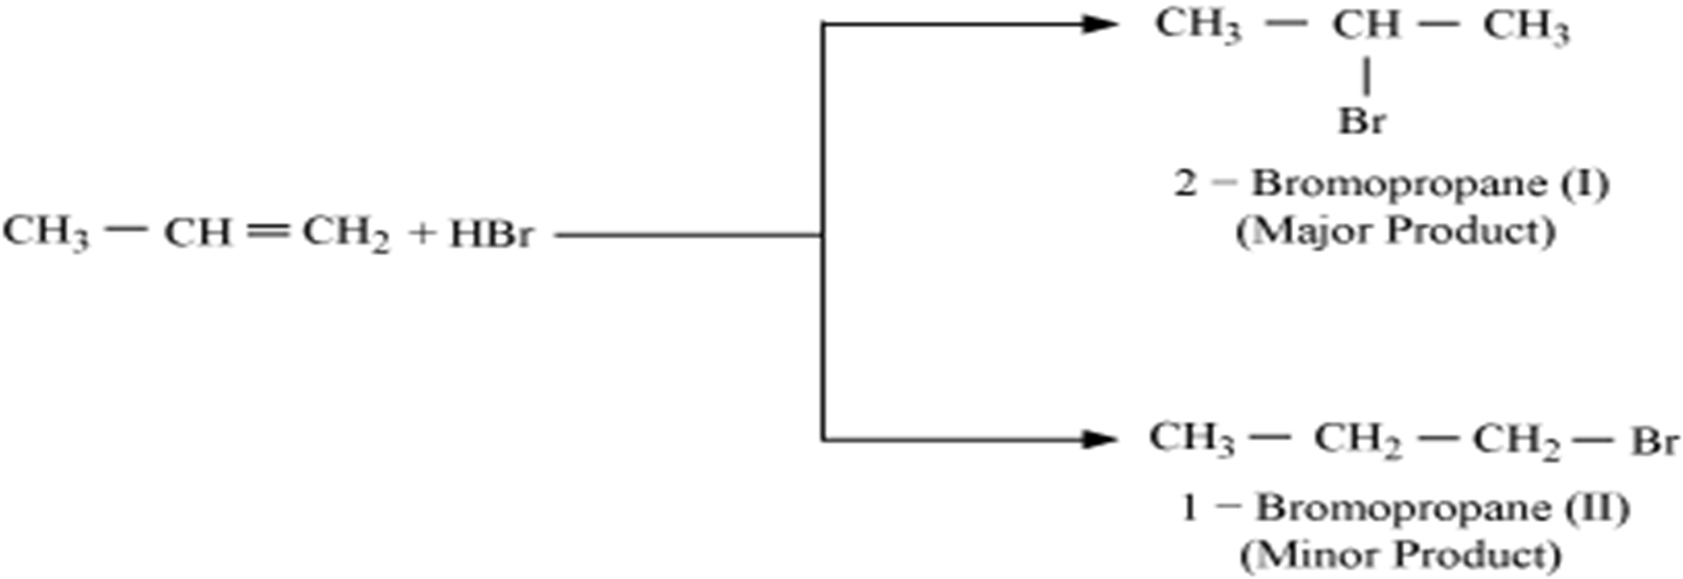
Markovnikov’s Rule in Electrophilic Addition Reactions
Markovnikov’s Rule helps predict the major and minor product formed when an electrophile adds to an asymmetric alkene.
Markovnikov’s Rule (Definition):
In the addition of HX(HF, HCl, HBr and HI) to an asymmetric alkene, the hydrogen (H⁺) attaches to the carbon with more hydrogen atoms, and the halide (X⁻) attaches to the carbon with fewer hydrogen atoms.

Slide 5
The chemical basis for this rule lies in the stability of the carbocation intermediate. When an alkene reacts with HX, the H⁺ adds to the carbon with more H-atoms, leading to the formation of a more substituted stable carbocation. This is because, more substituted carbocations (like tertiary or secondary) are more stable than primary carbocations.
This stability arises from hyper-conjugation and inductive effects, where adjacent alkyl groups donate electron density and stabilize the positive charge. As a result, the major product of the addition is the one that forms through the more stable carbocation intermediate.
Example (Stability Order):
(CH₃)₃C⁺ > (CH₃)₂CH⁺ > CH₃CH₂⁺ > CH₃⁺
(Tertiary), (Secondary), (Primary), (Methyl)

Slide 6
Anti-Markovnikov’s Rule in Electrophilic Addition Reactions
Anti-Markovnikov’s Rule helps predict the major and minor product formed when an electrophile adds to an asymmetric alkene in the presence of peroxide.
Anti-Markovnikov’s Rule (Definition):
In the presence of peroxides (ROOR) addition of HBr to the asymmetric alkene, the hydrogen (H•) adds to the carbon with fewer hydrogen atoms, and the bromide (Br•) adds to the carbon with more hydrogens.

Slide 7
Peroxides (ROOR) cause the reaction to proceed through a free radical mechanism. When an alkene reacts with HBr in the presence of peroxides, the Br• adds to the carbon with more H-atoms, leading to the formation of a more substituted stable carbon free radical. This is because, more substituted carbon free radicals (like tertiary or secondary) are more stable than primary carbon free radicals.
Example (Stability Order):
(CH₃)₃C* > (CH₃)₂CH* > CH₃CH₂* > CH₃*
(Tertiary), (Secondary), (Primary), (Methyl)
This stability arises from hyper-conjugation and inductive effects, where adjacent alkyl groups donate electron density and stabilize the free radical centre. As a result, the major product of the addition is the one that forms through the more stable free radical intermediate.

Slide 8
Nucleophilic Substitution Reactions
Substitution reactions involve the replacement of one atom or group in a molecule with another atom or group. Nucleophilic Substitution reaction is a reaction during which one Nucleophile in a compound is replaced by another Nucleophile.
A nucleophile is a species that is electron-rich and looks for positive or electron-deficient centers to attack. Basically, it donates a pair of electrons to form a new bond.
Ex: All anions, Molecules with lone pairs.
There are two types of Nucleophilic Substitution Reactions:
Unimolecular Nucleophilic Substitution Reactions (S_{N}¹ )
Bimolecular Nucleophilic Substitution Reactions (S_{N}²)

Slide 9
Unimolecular Nucleophilic Substitution Reaction (S_{N}¹) Characteristics
The S_{N}¹ mechanism involves two steps: first, the ionization of the substrate to form a carbocation intermediate, followed by the Nucleophilic attack on the carbocation to produce the final product.
Molecularity refers to the number of reacting species involved in the rate-determining step of a reaction. For an S_{N}¹ reaction, the Molecularity is one (unimolecular) because only one molecule is involved in rate-determining step.
The rate of S_{N}¹ reaction is first-order because it depends only on the concentration of the substrate (in the rate-determining step nucleophile absent). The reaction rate is independent of the concentration of the nucleophile.
Racemization is the process by which an optically active compound is converted into a racemic mixture 50:50 mixture of two enantiomers. S_{N}¹ reactions often lead to racemization because the carbocation intermediate is planar and the nucleophile can attack from either the front or the back side of the plane, leading to both inversion and retention products.
Polar, protic solvents (like water or alcohol) are favored for S_{N}¹ reactions. These solvents can solvate the leaving group and the carbocation, stabilizing them and thus facilitating the reaction.
Rearrangements can occur during the formation of the carbocation intermediate, and they play a significant role in determining the final product
Substrates with tertiary carbons, allylic or benzyllic carbons are most likely to undergo S_{N}¹ because they can form relatively stable carbocations. Secondary carbons can also undergo S_{N}¹, but primary carbons are highly unfavorable for this mechanism.
Order of Reactivity of substrate: Tertiary (3°) > Secondary (2°) > Primary (1°) > Methyl
8. A good leaving nucleophile and weak incoming nucleophile is essential for the reaction to proceed.
Order of Leaving Group: I⁻ > Br⁻ > Cl⁻ > H₂O > TosO⁻ >> F⁻ > OH⁻ > NH₂⁻

Slide 10
S_{N}¹ Reaction Example:
S_{N}¹ Mechanism: This reaction takes place in two steps
Step-I: Ionization of Alkyl halide
to produce carbocation.
Step-II: Attack of Nucleophile and
Deprotonation to produce product.

Slide 11
Bimolecular Nucleophilic Substitution Reactions (S_{N}²) Characteristics
The S_{N}² mechanism occurs in one concerted step, bond formation and bond breaking happen simultaneously. A nucleophile, attacks the carbon from the opposite the leaving group.
During the reaction, there is a transition state where the nucleophile is partially bonded to the carbon while the leaving group is still partially attached.
Due to the backside attack, the configuration of the carbon center inverts, like an umbrella flipping inside out, leading to Walden inversion.
The rate of an S_{N}² reaction is dependent on both the nucleophile and the substrate: Rate=k[Nucleophile][Substrate].
For an S_{N}² reaction, the Molecularity is two (Bimolecular) because two molecule (alkyl halide & nucleophile) are involved in rate-determining step.
Polar, aprotic solvents (Acetone, DMSO) are favored for S_{N}² reactions. they do not surround anions , so nucleophile remains “free” and reactive.
Since S_{N}² involves a backside attack by the nucleophile, steric hindrance (crowding around carbon) slows the reaction.
Order of Reactivity of substrate: Methyl > Primary (1°) > Secondary (2°) >Tertiary (3°)
8. In SN2 reactions, the incoming nucleophile is a strong electron donor, while the leaving group is a weak base that can easily leave the molecule after the nucleophile attacks.

Slide 12
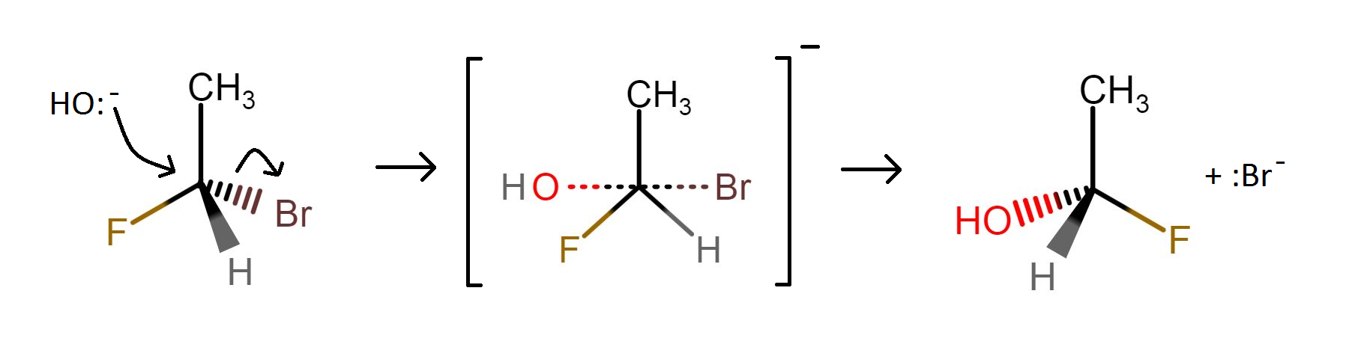
Mechanism of S_{N}² Reaction:
S-Isomer
R-Isomer
Walden inversion
product
Transition State

Slide 13
Comparison between S_{N}¹ Reaction and S_{N}² Reaction
Feature | S_{N}¹ Reaction | S_{N}² Reaction
1. Name | Unimolecular Nucleophilic Substitution | Bimolecular Nucleophilic Substitution
2. Rate Law | Rate = k[Substrate] | | Rate = k[Substrate][Nucleophile]
3. Steps | Two-step mechanism | One-step (concerted) mechanism
4. Intermediate | Carbocation | Transition state
5. Stereochemistry | Racemization (mix of retention + inversion) | 100% Inversion (Walden inversion)
6. Substrate Preference | 3° > 2° >> 1° (stable carbocation needed) | Methyl > 1° > 2° >> 3° (low steric hindrance)
7. Nucleophile Strength | Not important (can be weak) | Must be strong
8. Solvent Preference | Polar protic (water, alcohols) | Polar aprotic (DMSO, acetone)
9. Leaving Group | Must be good (stabilizes charge) | Must be good (same reason)
10. Rearrangements | Possible (hydride/methyl shifts) | Not possible
11. Rate-Determining Step | Formation of carbocation | Nucleophile attacking + leaving group leaving

Slide 14
Elimination Reactions
Elimination reactions are organic reactions in which two atoms or groups are removed from a molecule, typically forming a double bond (alkene) or, in some cases, a triple bond (alkyne).
β-elimination reaction, also known as a 1,2-elimination, involves the removal of two atoms or groups from adjacent carbon atoms to form a new π-bond. This reaction is a key step in the formation of alkenes.
Based on the mechanism these are further classified into two types:
Elimination unimolecular reaction (E₁): Two step reaction
Elimination bimolecular reactions (E₂): One step reaction

Slide 15
I. Elimination Unimolecular Reaction (E₁)
The E₁ mechanism involves two steps: first, the ionization of the substrate to form a carbocation intermediate, followed by the proton obstruct by base to produce the final product.
The rate of E₁ reaction is first-order because it depends only on the concentration of the substrate (in the rate-determining step base absent). The reaction rate is independent of the concentration of the base. Rate = k[substrate].
For an E₁ reaction, the Molecularity is one (unimolecular) because only one molecule is involved in rate-determining step.
Substrates with tertiary carbons, allylic or benzyllic carbons are most likely to undergo S_{N}¹ because they can form relatively stable carbocations. Secondary carbons can also undergo S_{N}¹, but primary carbons are highly unfavorable for this mechanism. Order : Tertiary (3°) > Secondary (2°) > Primary (1°) > Methyl
To remove proton weak bases (H₂O, ROH) are preferred.
Polar, protic solvents are favored for E₁ reactions. These solvents can solvate the leaving group and the carbocation, stabilizing them and thus facilitating the reaction.
The E1 reaction is not stereospecific and can lead to a loss of stereochemistry at the carbon bearing the leaving group.
E₁ reactions often compete with S_{N}¹ reactions, especially when the substrate can form a stable carbocation.

Slide 16
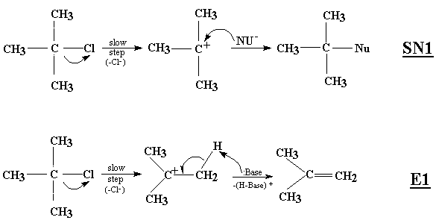
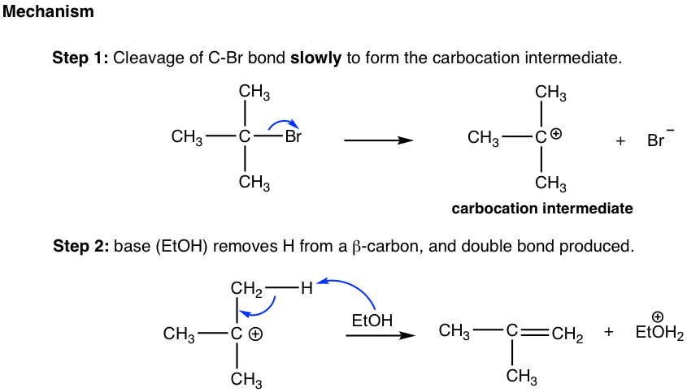
Elimination through E1-Reaction
EtOH
Br

Slide 17
Elimination bimolecular reactions (E₂)
E₂ reactions proceed in one step, with the proton abstraction, double bond formation, and leaving group departure occurring simultaneously.
The rate of reaction depends on both the substrate and the base: Rate=k[substrate][base]
A strong base (NaOH, KOH, NaOEt, t-BuOK) is essential to abstract the β-hydrogen effectively.
The hydrogen and leaving group must be anti-periplanar (in the same plane but pointing in opposite directions) for effective elimination.
E₂ is favored for 3° (tertiary) substrates where steric hindrance makes SN2 reactions difficult.
In 1° and 2° alkyl halides, E₂ can compete with SN2 reactions.
Saytzeff's (or) Zaitsev's rule predicts favored alkene products in elimination. In elimination reaction, the most substituted product will be the major product. This is because the transition state leading to the more substituted alkene is lower in energy.
Because the mechanism is concerted, carbocation rearrangement does not occur

Slide 18
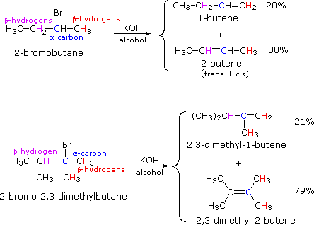

Slide 19
Comparison between E1 and E2 reactions
Feature | E1 Reaction | E2 Reaction
Name | Unimolecular Elimination | Bimolecular Elimination
Rate law | Rate = k [alkyl halide] | Rate = k [alkyl halide][base]
Molecularity | Unimolecular (1 molecule in RD step) | Bimolecular (2 species in RD step)
Mechanism | Two-step: 1. Formation of carbocation 2. Elimination | One-step concerted mechanism (proton loss and LG departure)
Carbocation intermediate | Yes, forms a carbocation | No carbocation formed
Order of reactivity | Tertiary > Secondary > Primary (very poor) | Tertiary > Secondary > Primary
Effect of base | Weak base is sufficient | Requires strong base
Stereochemistry | Not stereospecific | Requires anti-periplanar geometry
Competing reactions | Often competes with SN1 | Often competes with SN2
Solvent | Favored by polar protic solvents | Favored by polar aprotic or strong base in any solvent
Example base | Water, alcohol (weak base) | Ethoxide, hydroxide (strong base)
Example reaction | tert-butyl bromide in ethanol | 2-bromobutane + NaOEt → butene

Slide 20
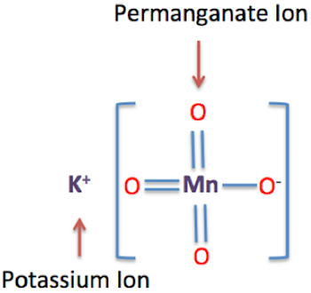
Oxidation by Potassium Permanganate
It has the chemical formula KMnO₄ and is a salt consisting of K⁺ and MnO⁻₄ ions. It is a strong oxidizing agent .
It dissolves in water to give intensely pink or purple solutions. In this compound, manganese is in the +7 oxidation state.
Its reactivity depends on whether it is used in acid, neutral or basic conditions.
In acid solution, Mn (VII) is reduced to Mn (II), while in basic and neutral conditions, MnO₂ is usually formed.

Slide 21
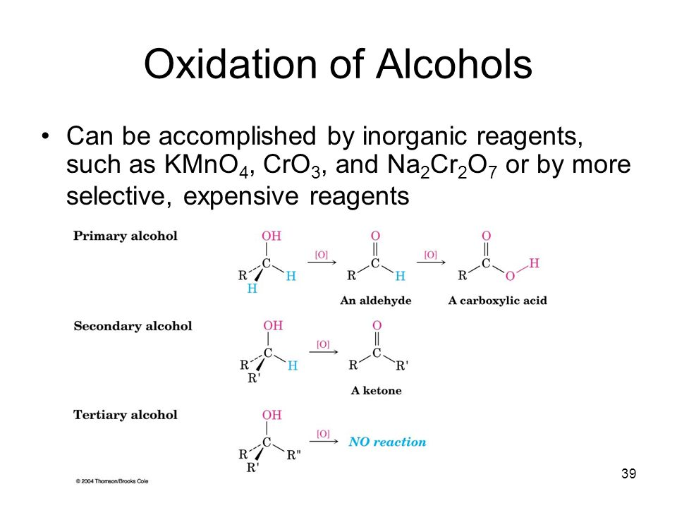
Primary Alcohols: KMnO4 can oxidize primary alcohols to aldehydes, and if the reaction is continued, the aldehyde is further oxidized to a carboxylic acid.
Secondary Alcohols: Secondary alcohols are oxidized to ketones.
Tertiary Alcohols: Tertiary alcohols are generally not oxidized by KMnO4 under typical conditions.

Slide 22
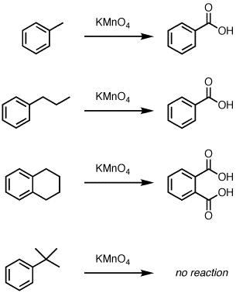
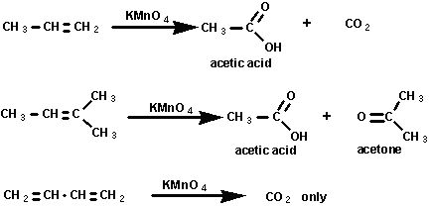
KMnO4 can cleave alkenes, breaking the carbon-carbon double bond and forming carbonyl compounds (aldehydes or ketones).

Slide 23
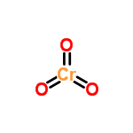

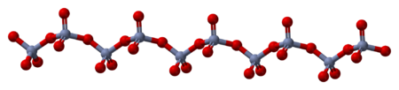
Chromium trioxide
Chromium trioxide formula is CrO₃. It is the acidic anhydride of chromic acid. Chromium trioxide is a powerful oxidizer and a suspected carcinogen.
The solid consists of chains of tetrahedrally coordinated chromium atoms.
Crystalline solid
Acidic solution

Slide 24
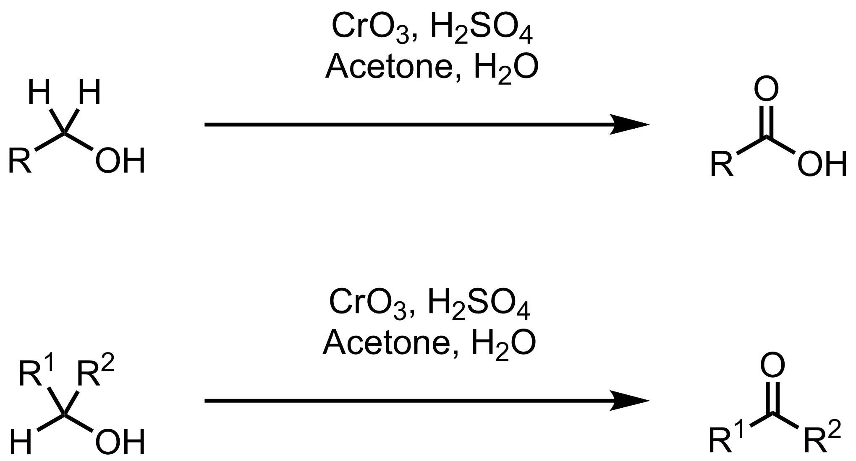
The Jones oxidation is an organic reaction used to oxidize alcohols using chromic trioxide and acid in water. A primary alcohol is oxidized to an aldehyde or all the way to a carboxylic acid, while a secondary alcohol to a ketone.

Slide 25
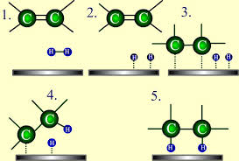
Reduction by Catalysts
Hydrogenation is a chemical reaction between molecular hydrogen (H₂) and another compound, usually in the presence of a catalyst such as nickel, palladium or platinum.
Hydrogenation reduces double and triple bonds in hydrocarbons.

Slide 26
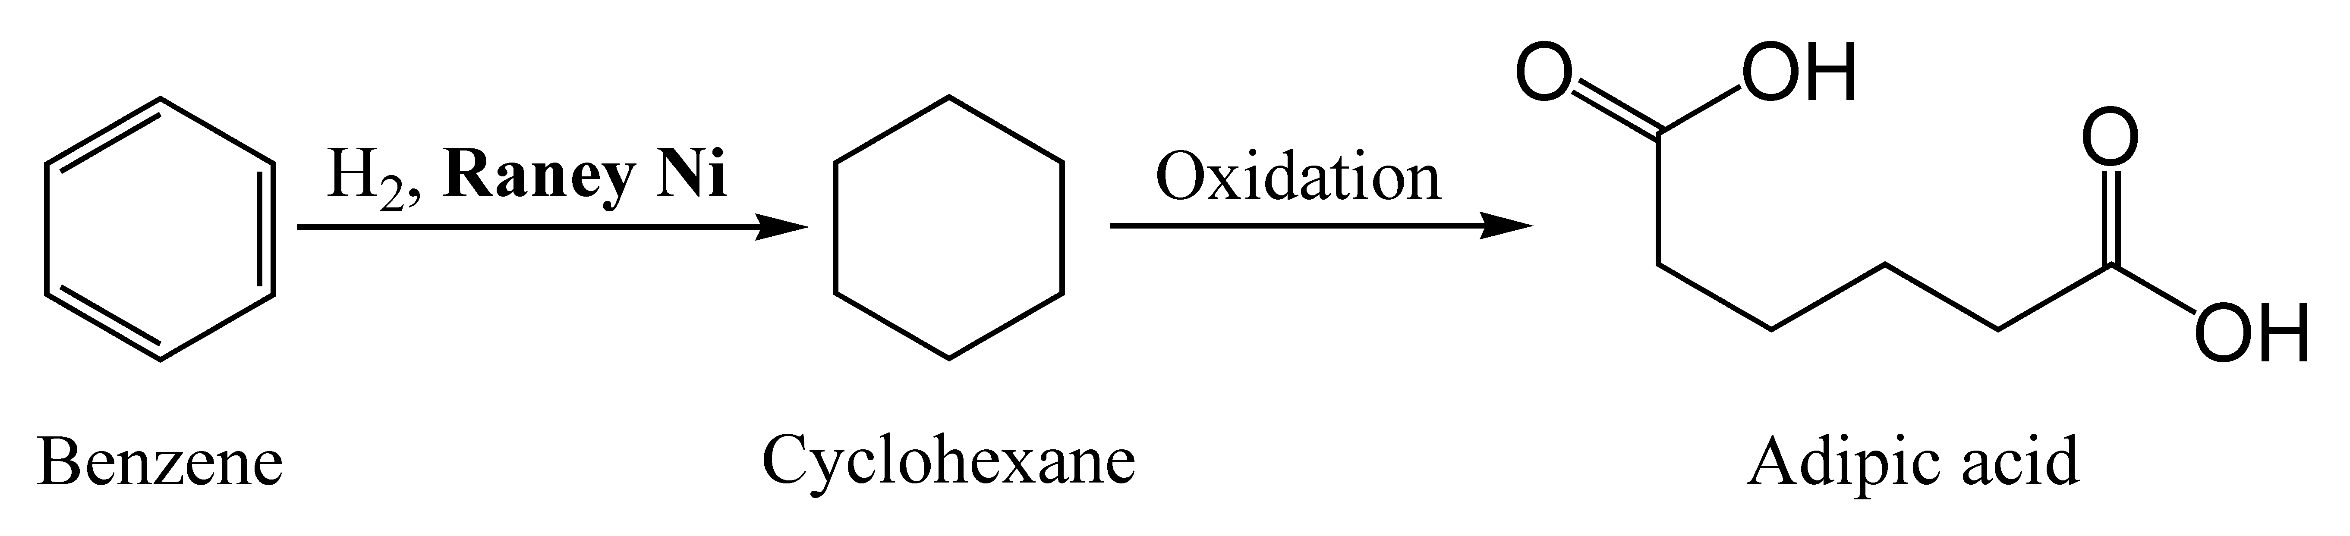
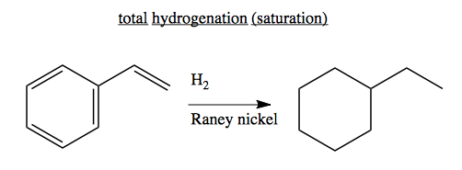
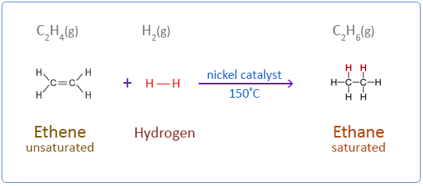
Catalytic Hydrogenation by Raney-Ni
1.
2.
3.

Slide 27
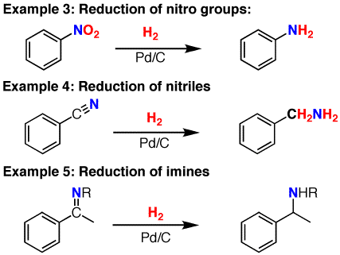
Catalytic Hydrogenation by Pd/C

Slide 28
Classification of Drugs Based on Effects on Users
A drug is any substance that, when taken into the body, alters its physiological or psychological functions. It may be used for:
Prevention of disease (e.g., vaccines)
Diagnosis (e.g., contrast agents in imaging).
Drug Type | Primary Effect | Common Examples
Stimulants | Increase alertness | Caffeine, Cocaine
Depressants | Slow body functions | Alcohol, Valium
Hallucinogens | Distort perception | LSD, Mushrooms
Narcotics | Pain relief & euphoria | Heroin, Morphine
Inhalants | CNS depression | Glue, Paint thinner
Cannabinoids | Alter mood/perception | Marijuana, Hashish
Designer Drugs | Mixed/club-related effects | MDMA, Ketamine
Treatment or cure of disease (e.g., antibiotics, painkillers)
Relief of symptoms (e.g., antihistamines for allergies)
Drugs can be natural, synthetic, or semi-synthetic, and they may be classified based on their origin, effects on the body, or therapeutic use

Slide 29
Classification Based on Therapeutic Use
Therapeutic Class | Purpose / Use | Examples
Analgesics | Relieve pain | Paracetamol, Ibuprofen
Antipyretics | Reduce fever | Aspirin, Paracetamol
Antibiotics | Treat bacterial infections | Penicillin, Amoxicillin
Antiseptics | Kill microorganisms on skin | Dettol, Iodine solution
Disinfectants | Kill microbes on non-living surfaces | Phenol, Bleach
Antacids | Neutralize stomach acid | Magnesium hydroxide, Gelusil
Tranquilizers | Reduce anxiety and tension | Diazepam, Alprazolam
Antidepressants | Treat depression | Fluoxetine, Sertraline
Antihistamines | Treat allergies | Cetirizine, Loratadine
Antimalarial | Treat malaria | Chloroquine, Artemisinin

Slide 30
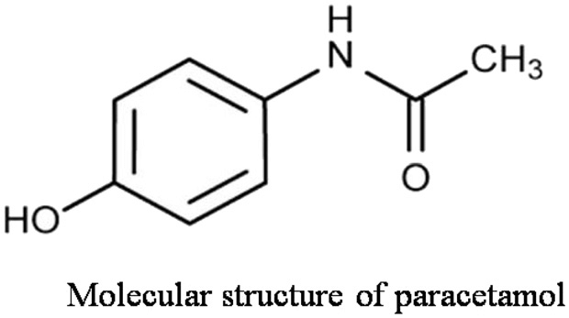
Paracetamol (Acetaminophen or APAP)
Primary Uses:
Pain relief (analgesic): for headaches, muscle aches, backaches, arthritis, toothaches, etc.
Fever reduction (antipyretic): often used to reduce fever in both adults and children.
Mechanism of Action:
It inhibits the synthesis of prostaglandins in the brain, which helps in reducing pain and fever.
Dosage (Typical for Adults):
500 mg to 1000 mg every 4–6 hours as needed, Maximum: 4000 mg per day (Exceeding the limit can cause liver damage.)
Side Effects (Rare at proper doses):
Nausea, Rash or allergic reaction, Liver toxicity (especially with overdose or chronic alcohol use)
N-acetyl-p-aminophenol

Slide 31
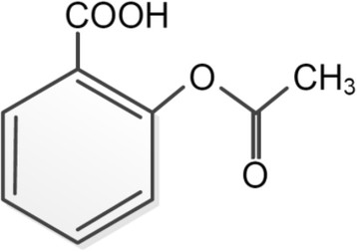
Aspirin(Acetylsalicylic acid)
Medical applications:
Pain Relief (Analgesic): Effective for mild to moderate pain (headache, muscle pain).
Anti-inflammatory: Reduces inflammation in conditions like arthritis.
Antipyretic (Fever Reducer): Lowers elevated body temperature.
Cardiovascular Benefits: Prevents heart attacks and strokes by inhibiting blood thinning.
Mechanism of Action: Inhibits cyclooxygenase (COX) enzymes. This blocks the production of inflammation mediators and thromboxane (promotes blood clotting).
Side Effects: Gastrointestinal bleeding, Vomiting, Allergic reactions, Increased bleeding risk
Condition | Typical Adult Dose
Pain/Fever | 300–600 mg every 4–6 hrs
Cardiovascular protection | 75–100 mg once daily
Rheumatic diseases | 2.4–3.6 g daily

Slide 32
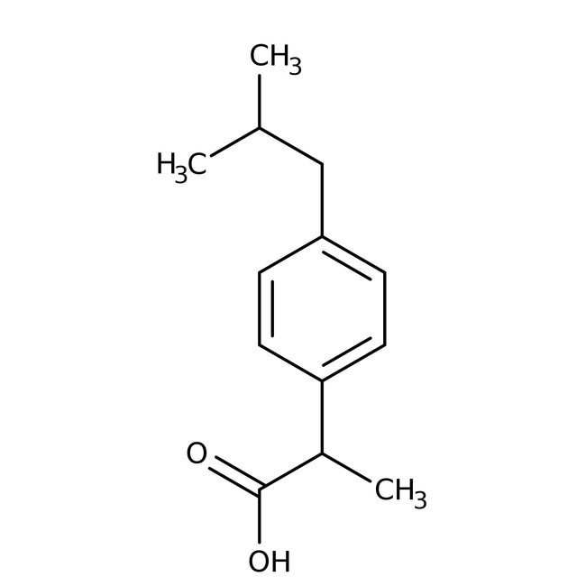
Ibuprofen
Uses of Ibuprofen:
Pain relief: Headaches, migraines, Toothaches, Muscle pain, Menstrual cramps, Arthritis pain.
Anti-inflammatory: Reduces swelling in conditions like rheumatoid arthritis or osteoarthritis.
Fever reduction: Commonly used to reduce fever in both adults and children.
Mechanism of action: Ibuprofen blocks cyclooxygenase (COX) enzymes, which are involved in the production of prostaglandins chemicals that promote inflammation, pain, and fever.
Side Effects: Stomach upset or pain, Heartburn, Nausea, Dizziness.
Dosage (Typical Adult):
200–400 mg every 4–6 hours, as needed
Maximum daily dose: 1200 mg (OTC), 2400 mg.

Slide 33
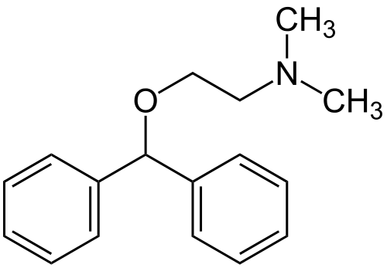
Diphenhydramine (Antihistamine)
Common Uses:
Allergic reactions: Sneezing, runny nose, itchy.
Motion sickness: To prevent nausea, vomiting.
Parkinson's disease: For relief of tremors.
Cold symptoms: In combination with other drugs.
Insect bites: Reduces itching and swelling.
Mechanism of Action:
Diphenhydramine blocks histamine H1 receptors, preventing the effects of histamine, a chemical involved in allergic responses.
Side Effects: Drowsiness, Dizziness, Dry mouth, nose, or throat, Constipation or urinary retention, Confusion (especially in older adults).

Slide 34
Spectroscopy
Spectroscopy is the study of the interaction between matter and electromagnetic radiation. It is a powerful analytical tool used in physics, chemistry, astronomy, and many other fields to determine the composition, structure, and properties of substances.
Basic Principle: When electromagnetic radiation interacts with matter, it can be absorbed, Emitted and scattered. Each element or molecule absorbs or emits radiation at specific wavelengths, producing a unique spectral fingerprint.
Types of Spectroscopy:
Type | Radiation Involved | Common Use
UV-Visible Spectroscopy | Ultraviolet/Visible light | Identifying concentration, compounds.
Infrared (IR) Spectroscopy | Infrared light | Identifying functional groups.
Nuclear Magnetic Resonance | Radio waves in magnetic field | Determining molecular structure
Mass Spectrometry | Ionized particles (mass/charge) | Determining molecular mass

Slide 35
Absorption and emission spectroscopy are two fundamental techniques in the field of spectroscopy, used to study the interaction between matter and electromagnetic radiation.
Absorption Spectroscopy | Emission Spectroscopy
Measures how much light is absorbed by a sample. | Measures the light emitted by a sample.
Electrons absorb energy and move to higher energy levels (excited state). | Electrons fall from higher to lower energy levels, release energy as light.
External light source required. | Sample emits light after excitation.
Decrease in intensity of transmitted light. | Detection of emitted light at specific wavelengths.
Energy is absorbed into the sample. | Energy is released by the sample.
UV-Vis, IR, Atomic Absorption Spectroscopy | Fluorescence, Atomic Emission Spectroscopy.
Dark lines/bands on a bright background. | Bright lines/bands on a dark background.

Slide 36
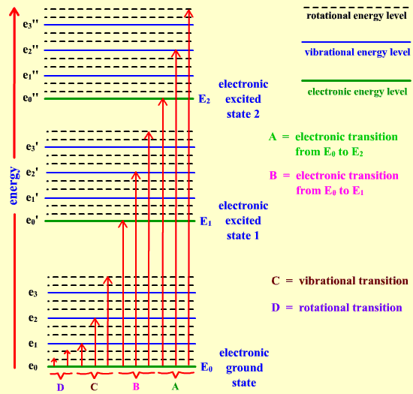
Electronic Spectroscopy or UV-Visible Spectroscopy or Rotational-Vibrational-Electronic Spectroscopy
Basic Principle: When a molecule absorbs light in the UV(~200–400 nm) or visible region(~400–800 nm), electrons in the molecule are excited from a lower energy level (usually a bonding or non-bonding orbital) to a higher energy level (usually an anti-bonding orbital).
UV-Visible spectroscopy is sometimes referred to as rotational-vibrational-electronic spectroscopy because when molecules absorb UV or visible light, they don't only undergo electronic transitions they also undergo accompanying vibrational and rotational transitions.

Slide 37
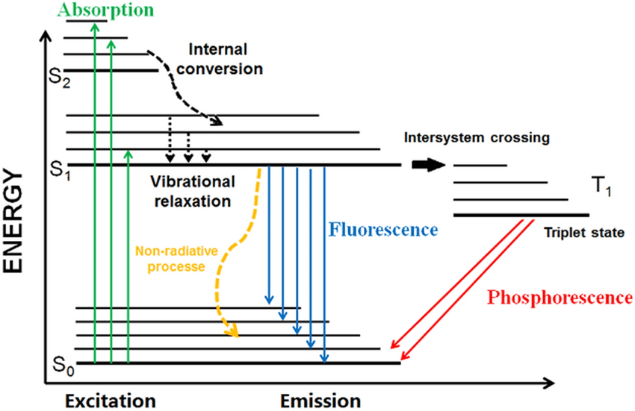
Post-Excitation Processes
After excitation, several things can happen:
Internal conversion (IC): Non-radiative transition between electronic states of the same multiplicity (e.g., S₂ → S₁).
Vibrational relaxation: Electron loses energy and falls to the lowest vibrational level of S₁.
Fluorescence: Emission of light as the electron falls from S₁ to S₀.
Intersystem crossing (ISC): Electron transitions from singlet S₁ to triplet T₁.
Phosphorescence: Emission from T₁ to S₀ (slower than fluorescence).
Non-radiative decay: Energy lost as heat (without light emission).
The Perrin-Jablonski diagram

Slide 38
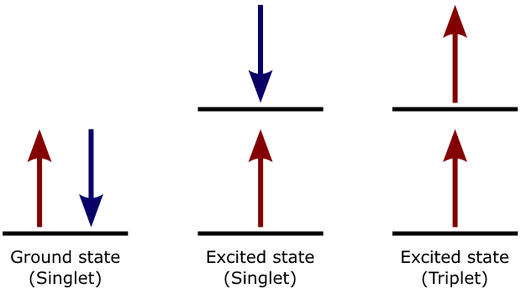
Singlet vs Triplet Excited States
Feature | Singlet Excited State (S) | Triplet Excited State (T)
Spin of Electrons | Opposite spins (paired) | Same spin (unpaired, parallel)
Spin Multiplicity | (2S + 1) = 1; (S=0) | (2S + 1) = 3; (S = 1)
Energy Level | Usually higher than triplet. | Lower than singlet state.

Slide 39
Possible Molecular Excitations in UV-Visible Spectroscopy
Excitation | Transition | Energy Level | Example
σ → σ* | From bonding to antibonding orbitals. | Highest energy (requires far UV) | Alkanes (C–C, C–H bonds)
n → σ* | From non-bonding (lone pair) to antibonding orbitals. | Medium-high energy | Saturated compounds with O, N, or halogens
π → π* | From bonding to antibonding orbitals. | Moderate energy | Alkenes, aromatic compounds
n → π* | From non-bonding (lone pair) to antibonding orbitals. | Lower energy | Carbonyls (C=O), nitro compounds

Slide 40
Selection Rules of Electronic Spectra
Selection rules are principles in quantum mechanics that determine whether an electronic transition is allowed or forbidden during the absorption or emission of light.
Here are the key selection rules for electronic transitions in UV-Visible spectroscopy:
Spin Selection Rule: The total spin quantum number must not change during a transition. ΔS=0. Transitions between singlet and triplet states (e.g., S1→T1​) are forbidden.
Laporte Selection Rule: In a centro-symmetric molecule, transitions that do not involve a change in parity (symmetry) are forbidden.
Allowed: g → u or u → g
Forbidden: g → g or u → u

Slide 41
Medical Applications of Fluorescence
Fluorescence is widely used in medical diagnostics and research due to its high sensitivity, specificity, and ability to provide real-time imaging. Here are the main applications:
Fluorescence Microscopy: Used to visualize cells, tissues, and organelles. Helps detect cancer cells, bacteria, and viruses.
Fluorescence-Guided Surgery: Real-time imaging technique used during tumor removal. Fluorescent dyes highlight brain tumors. Improves surgical accuracy.
Flow Cytometry: Measures cell size, complexity, and protein markers. Widely used in immunology, cancer diagnostics, and HIV monitoring.
Fluorescence In Situ Hybridization (FISH): Detects specific DNA or RNA sequences in cells. Used for genetic testing, cancer diagnosis.
Fluorescent Biosensors: Used for real-time detection of biomolecules. Employed in diabetes monitoring and pathogen detection.
Molecular Imaging: Combines fluorescence with MRI for targeted imaging. Tracks drug delivery, disease progression, or therapy response.

Slide 42
Infrared (IR) Spectroscopy (or) Rotational-Vibrational Spectroscopy
Infrared spectroscopy is a powerful analytical technique used to identify and study chemical bonds and functional groups in molecules based on their vibrational transitions.
IR spectroscopy involves low-energy radiation. This energy is sufficient to excite vibrational transitions and rotational transitions, insufficient to excite electronic transitions, which require much higher energy.
Selection Rules in IR Spectroscopy: Selection rules determine which molecular vibrations can absorb infrared (IR) radiation and appear in an IR spectrum.
Dipole Moment Change Rule: A vibrational mode is IR active only if it causes a change in the molecule’s dipole moment.
IR Active: Polar bonds like C=O, O–H, N–H (large dipole moment change)
IR Inactive: Symmetrical nonpolar molecules like O₂, N₂, Cl₂ (no dipole moment change).

Slide 43
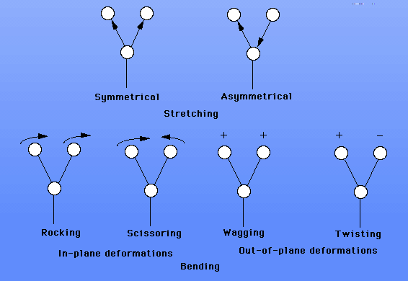
Possible Excitations with Infrared (IR) Light
Stretching vibrations change bond lengths. Bending vibrations change bond angles.
Stretching Vibrations: A stretching vibration changes the bond length. There are two types of stretching vibrations.
In symmetric stretching, two or more bonds vibrate in and out together.
In asymmetric stretching bonds are getting shorter at the same time as others are getting longer
Bending Vibrations: Bending vibrations change the angle between two bonds.
Scissoring : atoms move opposite direction with change in bond angle.
Rocking: atoms move same direction with change in bond angle.
Wagging: make a "V" sign with your fingers and bend them back and forth from your wrist.
Twisting: It is a motion as if the atoms were walking on a treadmill.

Slide 44
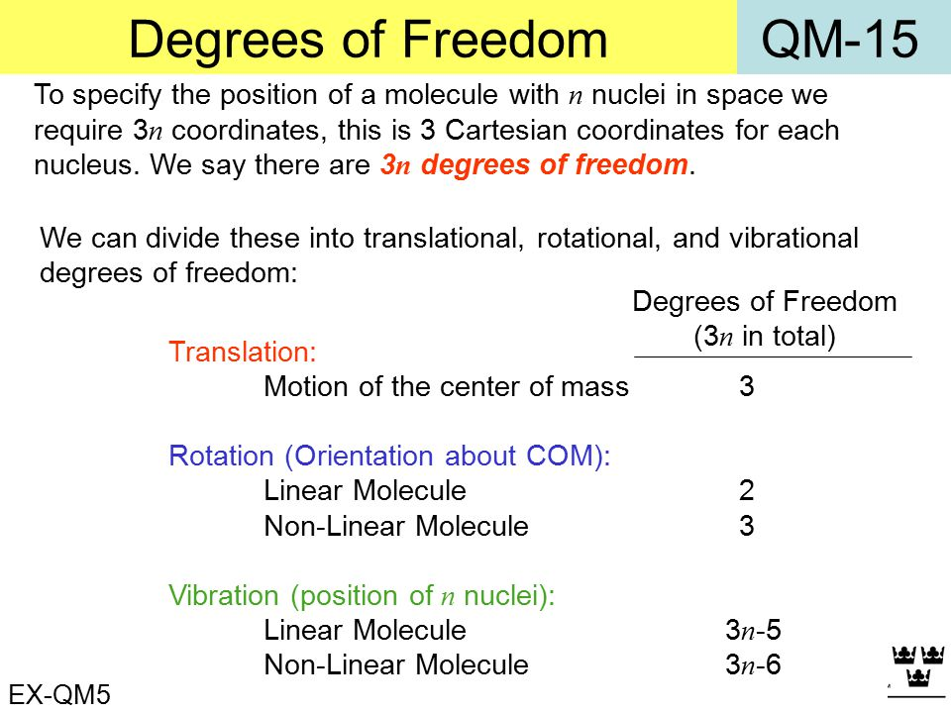
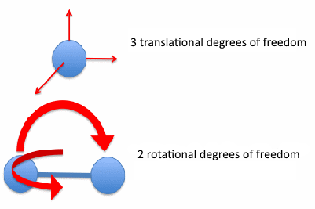
Degrees of Freedom in IR Spectroscopy
In IR spectroscopy, degrees of freedom refer to the independent ways a molecule can move through translation, rotation, and vibration. These are crucial in understanding how many vibrational modes a molecule can have.
Total Degrees of Freedom: Each atom in a molecule can move in 3 directions (x, y, z). Total degrees of freedom=3N (Where N = number of atoms in the molecule).

Slide 45
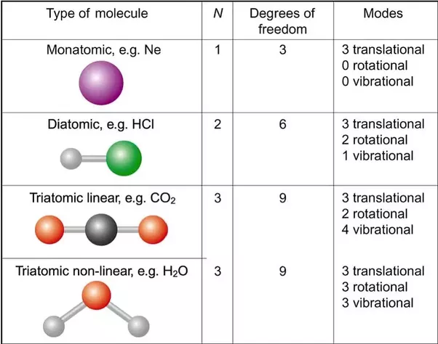

Slide 46
Long Answer questions
Explain the mechanism of electrophilic addition reactions with suitable examples.
Discuss Markovnikov's Rule with the help of a suitable example. What is its significance in electrophilic addition reactions?
Discuss Anti-Markovnikov's Rule with the help of a suitable example. What is its per-oxide effect?
Write the SN1 reaction mechanism with an example. Compare retention and inversion products.
Illustrate the SN2 reaction mechanism with an example. Compare retention and inversion products.
Compare SN1 reaction with SN2 reaction.
Describe the E1 reaction mechanism with a suitable example.
Develop the E2 reaction mechanism with a suitable example.
Sketch modes of electronic excitations with UV-Visible light.
Explain modes vibration with IR-light. What is degrees of freedom.
Write medical applications of Fluorescence.

Slide 47
Short answer questions
What is an electrophilic addition reaction?
What is Markovnikov’s rule? How does it apply to electrophilic addition?
Define Anti-Markovnikov’s Rule?
How does Anti-Markovnikov’s product differ from Markovnikov’s product?
Write per-oxide effect.
Does the SN1 reaction lead to retention or inversion of configuration? Explain briefly.
Why are tertiary carbocations more stable than primary ones?
What happens to the configuration of the product in an SN2 reaction?
Does the SN2 reaction proceed via a carbocation intermediate? Explain.
What is the major product formed according to Zaitsev’s Rule in E1 reactions?
Which type of alkyl halide favors the E1 mechanism most? Why?
Write Alcohol oxidation by KMnO4.
Write Structure two applications of Paracetamol, Aspirin, Ibuprofen.
Compare Singlet excitation state with Triplet excitation state .
Write selection rules for UV-Visible spectroscopy.

